Slide 1
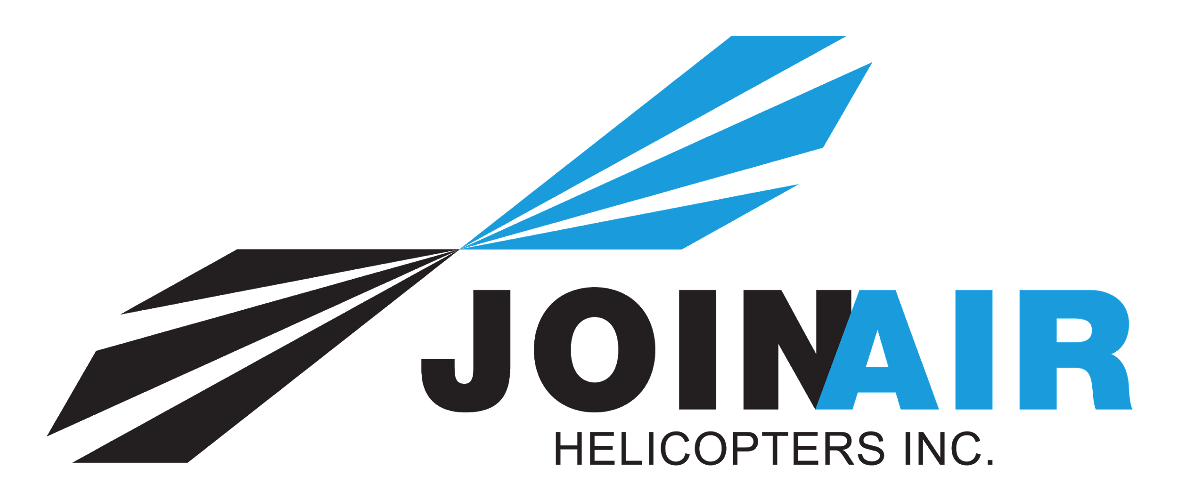
ENGINES
https://www.youtube.com/watch?v=gIdXLMVP6VU

Slide 2
POWER
Power is the rate of doing work. The amount of power an internal combustion engine can produce depends on the amount of heat in which can be generated
power produced by an engine is measured in horsepower.
power developed within an internal combustion engine is called indicated horsepower.
power available after friction and other losses, is called brake horsepower (BHP).

Slide 3
Types of Piston Engines
Horizontally opposed- most commonly used, two banks of cylinders working on the same crankshaft which lie directly opposite to each other.
Radial- odd number of cylinders in a circle.
In-line- cylinders are arranged side by side in a row along the crankcase. Generates little parasite drag.

Slide 4
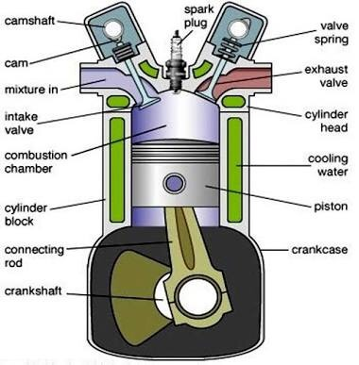
PARTS OF RECIPROCATING ENGINE
basic parts: crankcase, cylinders, pistons, connecting rods, valves, valve operating mechanism, camshaft and crankshaft, valves and spark plugs. Inside each cylinder is a movable piston connected to a crankshaft by a connecting rod.

Slide 5
REDUCTION GEARS
Many modern engines are geared, which means that the engine turns at a higher speed than the propeller which it drives. In this way, geared engines are made to develop greater power than direct drive engines with the same propeller speed.
The gearing consists of two sets of gear wheels. One of these is driven by the crankshaft and meshes with the other which, in turn, drives the propeller hub shaft. The reduction in speed is governed by the relative number of teeth in the two sets of gears.

Slide 6
AUXILIARY DRIVES
The crankshaft drives the propeller. It is also made to drive various auxiliary gears which in turn drive oil pumps, magnetos, generators, dynamos, air compressors, and other essential auxiliaries.
The auxiliary gears are generally grouped in a gearbox placed at the rear of the engine, to avoid increasing the frontal area.
In some cases a single flexible half-time shaft, driven by the crankshaft, is used to drive all the auxiliary gears.

Slide 7
THE FOUR- STROKE CYCLE
Almost all piston engines in use operates on what is known as the four-stroke cycle.
Induction stroke-The intake(sometimes called the inlet) valve open, the piston moves down from the top to the bottom of the cylinder creating a negative pressure.
The compression stroke- both valve closed, the piston moves up from the bottom to the top of the cylinder, compressing the mixture. The volume in the cylinder above the piston when it is at the bottom of the compression stroke is known as the compression ratio. Most gasoline engines use a ratio of between 6:1 and 7:1
The power stroke- both valves closed, the compressed mixture is fired by a spark plug. The burning gases, expanding under tremendous heat, create the pressure which drives the piston down with terrific force. This force is sufficient to complete the other three stroked in addition to providing the energy required for useful work.
The exhaust stroke-exhaust valve open, the piston moves up from the bottom to the top of the cylinder, pushing the burned gases out past the open exhaust valve. The intake valve remains closed.

Slide 8
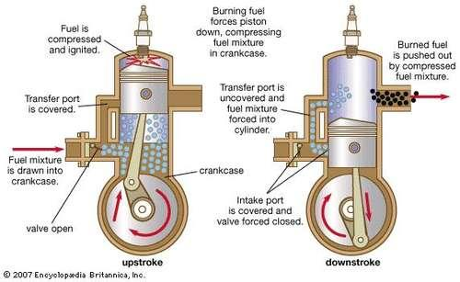
THE TWO-STROKE CYCLE
Small engines that operate on the principle of a two-stroke cycle are in common use in ultralight aircraft that are popular among recreational flying enthusiast.
The engine takes only 2 strokes of the piston to go through a complete power cycle. It differs from a four –stroke cycle engine in that it uses the crankcase as a fuel mixture transfer pump. Charging the crankcase with fuel, compression of the fuel change and ignition all take place on the upward stroke of the piston. Exhaust of the burned gases and transfer of the fuel to the cylinder take place on the downward stroke.

Slide 9
THE DIESEL ENGINE
The internal operating and design principles, and most moving parts, of a diesel engine are almost identical to those of a gasoline engine but there are some significant operational differences.
Diesels require no separate electric ignition source. Also they require no carburetor.
Diesel engines have fewer moving parts than gasoline engines, generate greater power per pound of fuel, and have more beneficial time-between-overhaul requirements.
The diesel does not require a mixture control, carburetor heat, or ignition control.

Slide 10
TURBOCHARGING
A turbocharger is installed between the air intake and the carburetor so that it compresses the air before it is mixed with the metered fuel in the carburetor.
Control of the turbocharger is provided by either an automatic control or a manual control. There are two types of the latter.
The simplest form of a manual control is the fixed bleed system which does not have a wastegate.
In operating a turbocharger system, it is important to be aware of throttle sensitivity and the need for slow and smooth throttle movements. The turbocharger does not react instantly but needs time to follow throttle movements and then stabilize.
The great advantage of turbocharging is the increased performance at altitude. A turbocharged engine is able to deliver full power at altitudes much above the service ceiling of a normally aspirated engine. Better climb performance, faster cruise at altitude, better take-off performance at high density altitude airports are therefore possible.

Slide 11
SUPERCHARGING
The supercharger is an internally driven compressor, powered directly from the engine. As much as 16% of the engine power can be required to drive the supercharger. It is installed downstream from the carburetor. This is called forced induction.
Forced induction may be used to increase the power of an engine at low altitudes. In this case the pressure over and above sea level atmospheric pressure which is forced into the manifold is called boost. This term is also used in the application of turbocharging.

Slide 12
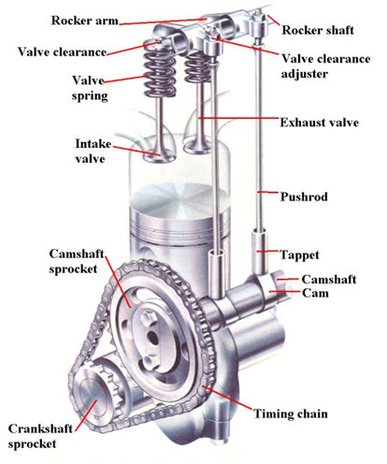
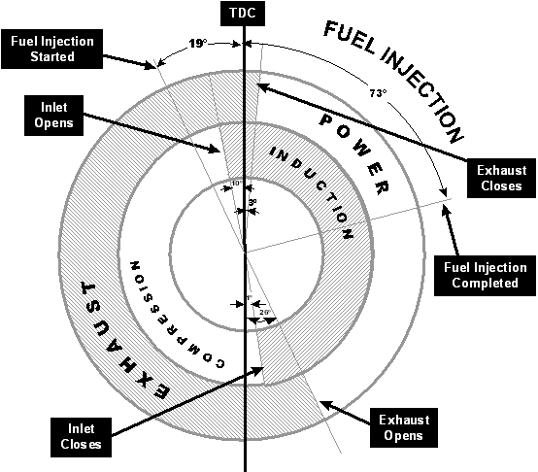
ENGINE TIMING
Better performance is obtained from the engine by what is known as valve lead, lag, and overlap. Valves require time to open and close. They therefore are timed to open early and close late in order not to waste any of the induction or exhaust strokes.
The valve mechanism is operated by a camshaft, which is driven by a gear that mates with another gear attached to the crankshaft. The camshaft rotates at one-half the speed of the crankshaft.

Slide 13
VALVE CLEARANCES
A clearance is necessary between the valve stem and the rocker to prevent the valve being forced off its seat when it gets hot and expands. This is called the valve clearance, or sometimes tappet clearance, of the engine.
The clearances are set cold, allowance being made for correct clearance to be attained when the valves reach their normal working temperature.
Clearances set too wide will cause a loss power, vibration and excessive water.
Clearances set too close are apt to warp the valves and cause serious trouble.

Slide 14
ENGINE COOLING
The heat of combustion reaches temperatures inside the cylinder that are as high as 2,500̊ c.
An appreciable portion of heat is absorbed by the engine parts, cylinder walls, piston heads, etc. This would cause excessive overheating, to the extent of actually fusing or melting the metal parts, if some means were not provided for dissipating it.
The engines of some aircrafts use a liquid coolant, but, by far the most common methods of dissipating engine heat is by circulating cooling air around the engine cylinders. Both horizontally opposed and radial engines are air cooled. Some in-line engines are air cooled, a few models are liquid cooled.

Slide 15
AIR COOLING
In air-cooled engines, fins are added to the cylinders to provide a greater area of metal to absorb the heat. Ram air passing over the fins absorbs this excess heat and carries it away. This cooling air enters the engine compartment through openings at the rear of the cowling.
Shrouds are used to direct airflow into the engine compartment. Baffles are used to force the cooling air directed by the shrouds, towards the cylinders and other engine parts such as magnetos and generators.
Cooling fans are sometime mounted on the front of the engine are gear-driven from the engine crankshaft. They assist the flow of cooling air at high altitudes where the weight-flow of cooling air is becoming light.

Slide 16
ENGINE OILS & LUBRICATION
Lubricating oil has four important functions to perform:
Cooling- carries away excessive heat generated by the engine
Sealing- provides a seal between the piston rings and cylinder walls, preventing “blow-by” loss of power and excessive oil consumption.
Lubrication- maintains an oil film between moving parts, preventing wear through metal to metal contact.
Flushing- cleans and flushes the interior of the engine of contaminants which enter or are formed during combustion.

Slide 17
METHODS OF LUBRICATION
In the force feed method the oil is forced under pressure from a pressure pump through the hollow crankshaft where it lubricates the main and big end bearings. It is then sprayed through tiny holes to lubricate the remaining parts of the engine by a fine mist, or spray.
In the splash method the oil is contained in a sump, or reservoir, at the bottom of the engine. It is churned by the revolving crankshaft into a heavy mist which splashes over the various engine parts. This type of lubrication is no longer used in engines that are manufactured today but it will be found in the engines of some of the older aircrafts that are still flying.

Slide 18
REQUIREMENTS OF GOOD OIL
Viscosity- resistance to flow. Stickiness or body. Good viscosity gives proper distribution of oil throughout the engine and prevents rupturing of the oil film which lubricates the engine parts over the wide range of temperatures. The use of oil too high viscosity for existing climatic temperatures will cause high oil pressure.
High flash point- the temperature beyond which a fluid will ignite. This should be in excess of the highest engine temperatures.
Low carbon content- to leave as little carbon as possible should oil work past scraper ring and burn. Good oil should also have a low wax content. Oils that have good resistance to deterioration and the formation of lacquer and carbon deposits are said to have good oxidation stability.

Slide 19
ADDITIVES
Some oils contain additives. These may be classified as follows:
Detergents: those which improve engine cleanliness.
Oxidation inhibitors: those which improve oil stability.
Anticorrosion additives: those which deter corrosion.
Pour point depressants: those which lower the pour point.
It is important that oil which contains additives should be added only to oil of the same type.

Slide 20
OIL TEMPERATURE
It is necessary to keep the oil temperature in an operating engine between certain well defined limits because the lubrication of the engine depends on the viscosity of the oil which, in turn, is governed by oil temperature.
If the oil gets too hot, its viscosity will be impaired and may not be enough to keep a good film of oil on the engine parts. If it gets too cold, the oil will become thick and will not flow through the passageways, resulting in improper lubrication.
Oil temperature is monitored by means of an oil temperature gauge which is installed on the instrument panel of the aircraft.
Engine manufacturers always specify operating limits which must be strictly observed , otherwise the life and reliability of the engine may be seriously impaired.

Slide 21
OIL DILUTION
The amount of oil dilution necessary is dependant on the expected temperature against which it is necessary to protect.
Oil dilution is recommended by most manufactures at 5 ̊ c and lower. The elapsed time required to achieve the amount of oil dilution required depends on two factors:
The rate of flow of gasoline into the oil
The amount of oil to be diluted.
One problem associated with oil dilution that a pilot must watch for is oil venting. If the engine is warmed up too rapidly at too high power settings, the gasoline in the oil will tend to vaporize so rapidly that the pressure within the engine crankcase will result in oil as well as gasoline being blown out through the engine crankcase breather. Care in following recommended procedures for completing boil-off will prevent this from happening.

Slide 22
THE FUEL SYSTEM
The aircraft fuel system stores and delivers the proper amount of fuel at the right pressure to meet the demands of the engine. It must deliver this fuel reliably throughout all phases of flight, including violent maneuvers and sudden acceleration and deceleration.

Slide 23
TYPE OF FUEL SYSTEMS
Fuel pump fuel system- an engine fuel pump supplies the pressure that keeps the fuel flowing to the engine. Such a system incorporates, as well as the basic pump, auxiliary electric pumps for use in emergency situations in case the engine driven pump fails. The booster pump, operated by a switch on the instrument panel, is also used to start the fuel flowing under pressure before the engine is running. A fuel pressure gauge, mounted on the cockpit panel, gives a visual indication that the fuel system is working by giving a reading of the pressure of fuel entering the carburetor.
Gravity feed fuel system- this is the simplest type of fuel system. The fuel tanks are mounted in the wings above the carburetor, with gravity causing the fuel to flow from the tanks, past the fuel selector valve to the carburetor. A drain allows removal of water and sediment trapped at the strainer. A primer sprays raw fuel into the intake manifold system or directly into the cylinders to aid engine starting, particularly in cold weather.

Slide 24
FUEL TANKS
The location, size and shape of fuel tanks vary with the type of aircraft in which they are installed.
The tanks are made of materials that will not react chemically with any aviation fuel. Aluminum alloy is most widely used.
Synthetic rubber or nylon bladder type fuel cells are also in use.
Usually a drain is provided at the lowest point of the tank through which water and sediment, which are heavier than fuel and therefore settle to the lowest point of the fuel tank, can be drained.
Overflow drains are also incorporated to release fuel and prevent tanks from bursting when fuel expands in the tanks.
The top of each tank is vented to the outside air to maintain atmospheric pressure within the tank. Tanks are also fitted with internal baffles to resist fuel surging caused by changes in the attitude of the aircraft.

Slide 25
FUEL SELECTOR VALVE
Permits the pilot to select the tank from which he/she wishes to draw fuel. It also has an “off” position which closes off the fuel flow entirely. When the aircraft is parked, the “off” position may be selected.

Slide 26
FUEL LINES AND FILTERS
The various tanks and other components of the fuel system are joined together by the fuel lines made of aluminum alloy metal tubing and flexible synthetic rubber or Teflon hose.
Coarse mesh strainers are installed in the tank outlets and often in the tank filler necks. Other strainers, made of fine mesh, are installed in the carburetor fuel inlets and in the fuel lines.
The main strainer is located at the lowest point in the fuel system. Its purpose is to prevent any foreign matter from entering the carburetor and to trap any small amounts of water that may present in the system.
Its good practice to drain the strainers prior to every flight to remove from the system any water that may be in the fuel. In cold weather, this water ,might freeze and stop the fuel flow, In warm weather, excessive water entering the carburetor could stop the engine.

Slide 27
FUEL QUANTITY GAUGE
Fuel quantity gauges are mounted on the instrument panel and give visual indication of the amount of fuel in each tank. A pilot should never assume that the instrument is correct but should make a visual check of each fuel tank before initiating a flight.

Slide 28
FUEL PRIMER
A small hand pump is located on the instrument panel. This is a primer that is used to pump fuel into the engine prior to starting. Ordinarily, it is needed only in cold weather.
A pilot should be careful not to over prime since this action may flood the engine and make it hard to start and, in some cases may even cause a fire.

Slide 29
FUEL TYPES
Fuels for modern high compression engines must burn slowly and expand evenly rather than explode quickly. The fuels which possess this quality are known as high octane fuels.
The octane rating of a fuel is arrived as follows:
Octane is a substance which possesses minimum detonating qualities.
Heptane is a substance which possesses maximum denoting qualities.
The proportion of octane to heptane in a fuel is expressed as a percentage. Hence, 73 octane means 73% octane and 27% heptane characteristics in the fuel. The natural gas limit is 72 octane. Fuels of higher octane than this are treated with tetraethyl lead or “cracked” by a heat process which increases their volatility.
Octane numbers go as high as 100. Beyond this number, the antiknock value of the fuel is expressed as a performance number.
It is the pilot’s responsibility to see that proper grade of fuel is used in refuelling the aircraft.
If the proper grade of fuel is not available and the engine must be operated, use the next higher grade. Never use a lower grade. The engine will overheat badly, detonation may occur and engine damage may result.

Slide 30
FUEL RELATED PROBLEMS
Detonation- characterized by the inability of a fuel to burn slowly and is generally defined as an abnormally rapid combustion, replacing or occurring simultaneously with normal combustion. Also characterized by its almost instantaneous nature, as contrasted with the smooth progressive burning of normal combustion. Under conditions of denotation, cylinder pressures rise quickly and violently to peaks that are often beyond the structural limits of the combustion chambers. Detonation is dangerous and costly. A rapid increase in cylinder head temperature, often indicates detonation. Throttle reduction is the most immediate and surest remedy.
Pre-ignition- is a premature ignition of the mixture due to glowing carbon particles, or “local hot spots”. It is often experienced when attempting to start a hot engine and usually results in a backfire through the intake manifold.
Vapour lock- in a fuel line can be caused by high atmospheric temperatures, causing gas to vaporize and block the flow of liquid fuel in the line.

Slide 31
THE CARBURETOR AND FUEL INJECTION
The function of the carburetor is to measure the correct quantity of gasoline, vaporize this fuel, mix it with the air in the proper proportion and deliver the mixture to the cylinders.
The ratio of fuel to air is regulated by the pilot with the mixture control. The throttle regulates the flow of air into the engine and creates turbulence at the butterfly valve to assist in the mixing of fuel and air. The carburetor matches the flow of fuel with the air flow to achieve the ratio regulated by the mixture control.
In the fuel/ air mixture delivered to the cylinders from the carburetor, the proportion of gasoline to air is governed by weight and nor by volume. Mixture is a very precise measurement, as the fuel to air ratio for best power is only 2 to 4 pounds of fuel per 100 pounds of air different from the ratio which will cause a lean misfire condition.
Fuel/ Air ratios by weight indicate the effect, on a typical engine, of varying the mixture ratio at full throttle, constant speed.
Running mixture | About 1 to 8
Best Power Mixture | About 1 to 14
Chemically Correct Mixture | About 1 to 15
Lowest Fuel Consumption Mixture | About 1 to 18
Leanest Running Mixture | About 1 to 20

Slide 32
THE FLOAT CARBURETOR
Fuel flows through the fuel supply lines, past the fuel strainer and enters the carburetor at the float (or needle) valve. It flows into the float chamber where its level is controlled by a float which opens or closes the float valve as it rises or falls. When the float rises to a predetermined level, it shuts of the float valve. No additional fuel can then enter the carburetor until the fuel is used by the engine.
The float chamber is vented so that the pressure in the chamber equalizes with the atmospheric pressure as the aircraft climbs and descends. The level of gasoline in the float chamber governs the level of gasoline in the nozzle. One problem with the carburetor is that sometimes the float may become punctured so that gasoline leaks into it increasing its weight. As a result, the level of gasoline in the chamber rises and gas overflows from the nozzle, thereby flooding the carburetor.

Slide 33
THE PRESSURE CARBURETOR
Fuel under pressure is injected into the intake manifold where it is mixed with the incoming air prior to entering cylinder through the intake valve. In this way, the hazard of carburetor ice is eliminated because the fuel is injected beyond the venturi, thus canceling additive cooling effects of lower pressure and vaporization. A throttle control valve regulates the flow of the intake air.

Slide 34
IDLING
When an engine is idling, the throttle valve is closed and there is insufficient movement of air through the venturi to lower the pressure enough to draw fuel from the main nozzle. An idle jet is provided at the edge of the closed throttle valve where, owing to the narrow passage, the air accelerates and reduces the pressure enough to draw fuel from the idle jet.

Slide 35
ACCELERATION PUMP
During rapid acceleration, the fuel in liquid form, which travels to the cylinders along with the vaporized fuel and air, is unable to increase its velocity as rapidly as does the air. This causes a temporary leanness at the cylinders which must be compensated for by temporarily adding more fuel at the carburetor. This is accomplished by the acceleration pump. The device consists of a piston controlled by the throttle which works up and down in a cylinder containing gasoline at the float level. The piston is drilled with two holes beneath which is a check valve. When the throttle is opened slowly, the check valve remains open and no fuel is pumped. When the throttle is opened quickly, however, the check valve closes and the fuel in the cylinder is pumped into the airstream through the economizer discharge needle.

Slide 36
MIXTURE CONTROL
The need to have a mixture control system is occasioned by the fact that, as altitude increases, the density of the air decreases. Carburetors are normally calibrated for sea level operation, which means that the correct mixture of fuel and air will be obtained at sea level with the mixture control in the full rich position.
As altitude increases, a given volume of air weighs less. It is obvious then that at higher altitudes, the proportion of air by weight to that of fuel will become less although the volume remains the same.
Rich mixtures- high power settings
Leaner mixtures- cruise power settings

Slide 37
AUTOMATIC MIXTURE CONTROL
Some engines are fitted with a mixture control which automatically compensates for changes in the pressure and temperature of the air entering the carburetor.
The device consists of a sealed bellows containing gas which expands and contracts with changes in pressure and temperature. The movement of the bellows is used to operate the mixture control valve automatically.

Slide 38
WHEN TO LEAN THE ENGINE
At cruise power, below approximately 75 percent of the rated rpm of the engine, it is generally permissible and recommended to use, at any altitude above 5,000 feet, the mixture control as an economy device. The mixture may be leaned to “lean best power”. Care must be exercised, however, when using the mixture control as a fuel economy device, because selecting too lean of a mixture will increase operating temperatures in the combustion chamber.
At high manifold pressures, the mixture control should be set at full rich. For taking off or landing at airports at any elevation up to 5,000 feet density altitude and for climbing up to 5,000 feet, the mixture control should be in the full rich position.
When taking off at high altitude airports where the density of the air is reduced. The mixture should be leaned in order to get the maximum power from the engine since an over-rich mixture results in loss of power.
To lean the mixture prior to take-off, position the aircraft at the end of the runway, lock the brakes and advance the throttle to full power. Adjust the mixture control by the method listed above to “rich best power”

Slide 39
WHY TO LEAN THE ENGINE
Economy of fuel which means lower costs of operation
A smoother running engine. Excessively rich mixtures make the engine run rough and cause vibrations which might cause damage to engine mounts and engine accessories.
A more efficient engine, giving higher indicated airspeeds and better performance.
Extended range of the aircraft at cruise.
Less spark plug fouling and longer life for spark plugs.
More desirable engine temperatures.
Cleaner combustion chambers and therefore less likelihood of pre-ignition from undesirable deposits.

Slide 40
CARBURETOR ICING
Under certain moist conditions, with air temperatures ranging anywhere from approximately -5̊ c to 30̊ c, it is possible for ice to form in the induction system.
Carburetor icing is usually indicated by loss of power. If severe enough, carburetor icing may cause complete engine failure, as the icing situation closes off entirely the induction flow.
Ice that forms in the carburetor is caused by two processes:
The drop in temperature as heat is taken from the air in order to effect vaporization of the fuel
From cooling due to the low pressure area in the carburetor.

Slide 41
PREVENTION OF CARBURETOR ICING
Awareness of the possibility of icing conditions and a keen understanding of how ice affects engine operations are the pilot’s best weapons against carburetor icing.
Be sure the carburetor heat system and controls are in proper working conditions
Always start the engine with carburetor heat in the cold air position to avoid damage to the carburetor heat system.
Always, in the pre-flight check, include a check of carburetor heat availability and note the ON power drop.
In cold weather, hot air may be used for warm-up and taxiing prior to take-off. Extremely low temperatures cause the engine to run lean. Carburetor heat will enrich the mixture and help to vaporize the fuel.
Use cold air selection for take-off. The less dense heated air that enters the induction system when carburetor heat is selected causes a reduction in power. Carburetor heat at high power settings can cause engine overheating and possibly detonation.

Slide 42
FUEL INJECTION
A fuel injected engine produces slightly more power and uses less fuel than a carbureted engine of equal displacement and compression ratio.
The fuel injection pump delivers the fuel to the nozzles.
Fuel injection engines have the reputation of being difficult to start when the engine is hot. When a hot engine is shut down, the heat inside the cowling may cause the fuel in the lines to vaporize. At the next start, the vapour in the lines prevents the engine from getting enough fuel to effect a start.
To successfully start a hot engine, it is necessary to remove all the fuel vapours and get liquid fuel in the lines. This is done by activating the booster pump for a short period of time.

Slide 43
THE EXHAUST SYSTEM
There are two main types of exhaust systems:
The short stack system
The collector system
The collector system is used on most large engines and on all turbocharged engines.
Most exhaust systems are made of stainless steel.
One some aircraft engine installations, cooling air is drawn in and around the engine by means of a speciality designed exhaust system called the augmentor system.

Slide 44
THE IGNITION SYSTEM
The function of the ignition system is to supply a spark to ignite the fuel/air mixture in the cylinders. The ignition system comprises two magnetos, two spark plugs in each cylinder, ignition leads and a magneto switch.
The magneto is an engine driven generator that produces an alternating current. Its source of energy is a permanent magnet and it operates on the principle of the “polarity of a magnet”.

Slide 45
MAGNETO
The complete magneto combines all the elements of an entire ignition system; that is, it:
Generates a low tension current above.
Transforms this to high tension.
Distributes the current to the individual spark plugs at the time it is desired to have them fire.

Slide 46
DUAL IGNITION
The purpose of a dual ignition is two-fold.
Safety. If one system fails, the engine will still operate.
Performance. Improved combustion of the mixture increases the power output and gives better engine performance.

Slide 47
SHIELDING
To prevent the ignition current interfering with the radio, the whole ignition system, magnetos, plugs, and wiring, are surrounded with a metal covering which is grounded. This is known as shielding.

Slide 48
IGNITION TIMING
Ignition timing means timing the magneto to fire at the right time. Timing is, of course, critical to good engine performance. Advanced firing of the spark plug results in loss of power and in overwhelming that can lead to denotation and pre-ignition, piston burning, scored cylinders and broken rings. The timing of the magnetos should be checked at least every 100 hours to ensure proper operation.

Slide 49
THE FADEC SYSTEM
Full authority digital engine control (FADEC) is a new aviation parlance describing some of the innovations taking place in aero engine systems technology.
FADEC has moved its way into the general aviation environment from its beginnings in the military and turbine-powered aircraft industry.
FADEC technology eliminates the manual mixture control, does away with carburetors and magnetos, and provides essentially single lever power control for the general aviation pilot.

Slide 50
THE PROPELLER
The function of the propeller is to convert the torque, or turning movement, of the crankshaft into thrust, or forward speed.
The propeller is designed so that as it rotates, it moves forward along a corkscrew or helical path. In doing so, it pushes air backward with the object of causing a reaction, or thrust, in the forward direction.
The propeller blade is an airfoil section. It meets the air at an angle of attack as it rotates and thus produces lift and drag.
Propellers which are attached forward of the engine and which pull from the front of the aircraft are called tractors.
Those which are attached aft of the engine and push from behind are called pushers.

Slide 51
PITCH
The distance in feet a propeller travels forward in one revolution is called pitch.
If the propeller was working in a perfect fluid, the distance it would travel forward in one revolution would be a theoretical distance dependant on the blade angle and diameter of the propeller. This is called the theoretical pitch or geometric pitch.
In a medium such as air, the propeller encounters lost motion and the distance it travels forward is somewhat less than its theoretical pitch. The lesser distance is called the practical pitch or effective pitch.
The difference between the theoretical pitch and practical pitch is called the propeller slip.
Course pitch- a propeller set in course pitch will travel forward a greater distance with each revolution and hence the aircraft will move forward at greater speed for a given rpm.
Fine pitch- have less torque, or drag, and will consequently revolve at higher speed around its own axis, thereby enabling the engine to develop greater power. A fine pitch propeller gives the best performance during take off and climb. Also sometimes known as low pitch or as increase rpm, or as high rpm.

Slide 52
TYPES OF PROPELLERS
Fixed pitch propellers: the blade angles cannot be adjusted by the pilot. The angle of the blade is chosen by the manufacturer to give the best performance possible for all flight conditions.
Variable pitch propellers:
Adjustable pitch propeller- are those whose blade angle may be adjusted on the ground. They offer some advantage over the fixed pitch propeller in that the propeller pitch can be adjusted for varying flight situations. When operating at high altitude airports or when operating on floats when take-off and climb performance is critical, a fine pitch can be selected to give better performance for that particular type of operation.
Controllable pitch propeller-are those whose blades can be adjusted by the pilot to various angles during flight.
Constant speed propeller- are those whose blades automatically adjust themselves to maintain a constant rpm as set by the pilot.

Slide 53
FEATHERING
Feathering means turning the blades to the extreme coarse pitch position, where they are streamlined and cease to turn.
Feathering reduces the drag on the blades. It stops the propeller from wind milling and possibly causing damage to detective engine. It also stops excessive vibration.
For feathering or unfeathering, an auxiliary oil pressure supply is required, since the engine is no longer running. This pressure is supplied by an auxiliary, or feathering, pump operated by an electric motor. The auxiliary oil pressure is supplied to either face of the piston to move the blades towards “feather” or “unfeather”, as the case may be, through the pilot valve system. A push-button feathering switch, or in some installations a feathering lever, is operated manually by the pilot to feather or unfeather the propeller.

Slide 54
PROP REVERSING
To make propeller braking by reverse thrust as natural as possible to handle, an “instinctive” throttle quadrant arrangement is provided by the majority of airframe manufacturers.
All throttle positions forward of the center of the quadrant are for forward thrust operation and are referred to as the alpha range. The rear section of the quadrant is the reverse range and is referred to as beta range.

Slide 55
CARE OF THE PROPELLER
Propellers should be checked regularly for damage.
Keep blades clean.
Avoid run-ups in areas containing loose rocks or gravel, and never move the aircraft by pushing or pulling on the propeller blades.
When performing an inspection, inspect blades completely, not just the leading edge, for erosion, scratches, nicks and cracks.

Slide 56
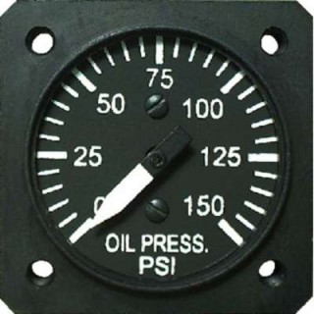
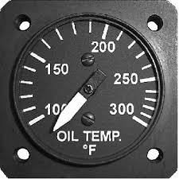
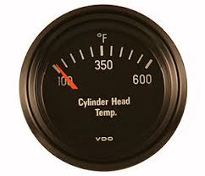
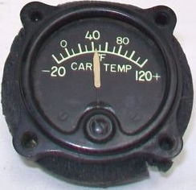
ENGINE INSTRUMENTS
Oil pressure gauge is one of the principle engine instruments and is usually located on the instrument panel with oil temperature and the fuel gauges. It indicates the oil pressure supplied by the oil pump to lubricate the engine. Should be checked immediately after the engine has been started. If the oil pressure does not register within 10 seconds, the engine should be shut down and checked.
Oil temperature gauge is normally located beside the oil pressure gauge. It gives a reading of the temperature of the oil in degrees Fahrenheit or Celsius.
Cylinder head temperature gauge records the temperature of one or more of the engine cylinder heads. The instrument gives a reasonable good indication of the effectiveness of the engine cooling system. It should be monitored frequently during steep climbs to ensure sufficient cooling air is reaching the engine.
Carburetor air temperature gauge may be installed to indicate the temperature of the mixture entering the manifold, or it may record the temperature of the intake air entering the carburetor. Its purpose is to enable the pilot to maintain a temperature that will assure maximum operating efficiency and warn them of icing conditions in the carburetor that may lead to engine failure.

Slide 57
ENGINE INSTRUMENTS
Outside air temperature gauge records the ambient air temperature, that is, the temperature of the free air surrounding the aircraft. To ensure that the temperature recorded is true, the element is shielded from the sun’s radiation and located in a portion of the airflow that is relatively undisturbed. The temperature recorded by the gauge is not, however, entirely accurate.
The dynamic pressure of the ram air causes a slight increase in temperature above that of the ambient air. The indicated temperature must be corrected to get true air temperature (TAT). Knowledge of the true air temperature enables the pilot to select proper manifold pressure, to calculate the true airspeed and altitude and warns of conditions that may cause ice formation.

Slide 58
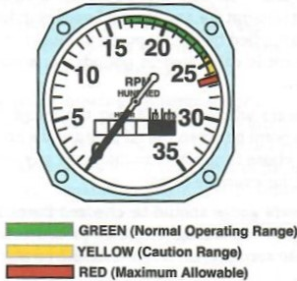
ENGINE INSTRUMENTS
Tachometer, or rpm indicator is an instrument which shows the speed at which the engine crankshaft is turning in hundreds of revolutions per minute. This instrument usually incorporates a recording mechanism that keeps an accurate record of the engine hours.
Tachometers are of many types:
Mechanical, either Centrifugal or magnetic
Electrical, either direct or alternating current.
Tachometer markings: tachometer is colour coded to give a ready indication of the proper range of engine operation. The green arc indicates the normal range of operation. The rpm settings within this range should be used for continuous operations. The yellow arc indicates the caution range in which there is a possibility of engine damage under certain conditions. The red line is the maximum limit.
Operation of the engine at greater speeds that those recommended may result in excessive mechanical stresses and may cause failure of major engine parts.

Slide 59
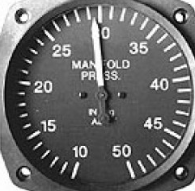
THE MANIFOLD PRESSURE GAUGE
The instrument is usually located on the instruments panel adjacent to the tachometer so that the pilot can refer to both instruments when making power settings.
It indicates in inches of mercury the pressure of the fuel/air mixture in the engine intake manifold at a point between the carburetor and the cylinders.
A manifold reading of 26” Hg indicates a pressure of about 13 pounds per square inch (psi) in the engine intake manifold.
When the engine is not running, the reading on the manifold pressure gauge will be that of the existing atmospheric pressure. When the engine is running, the pressure inside the intake manifold is lower than that of the outside atmospheric pressure because the pistons create a partial vacuum.
When increasing power, increase the rpm first and then the manifold pressure.
When decreasing power, decrease the manifold first and then the rpm.

Slide 60
OPERATION OF THE ENGINE
Never make abrupt movements on the throttle. Such action can lead to damage and eventual engine failure.
One take-off open the throttle slowly and steadily to take-off power. In this way, the engine is able to accelerate in rpm at the same pace as the advancing throttle; the increase in rpm and manifold pressure keep pace and there is little possibility of over boost of the engine cylinders; the propeller governor, propeller pitch control mechanism has adequate time to respond to the increasing rpm without risking overspeed condition and, temperature changes within the cylinder and piston assemblies take place more slowly reducing the possibility of overstress, cracking and breaking that are caused by very rapid temperature changes.

Slide 61
ENGINE MAINTENANCE AND CARE
Change oils at intervals recommended
Installation of auxiliary oil filters are recommended to assist in preventing foreign matters from circulating through the engine and causing excessive wear.
All oil filters should be regularly inspected and cleaned.
Service spark plugs regularly and replace them when they are work to their limits.
Inspect ignition harness regularly to assure against worn insulation and seals that would cause misfiring.
Have the magneto points and timing checked as recommended and have a compression check run regularly.
Check the intake manifold periodically to be sure there are no loose connections.
Air inlet filter screens should be cleaned regularly so they can perform their function of keeping sand and dust from entering the induction system.

Slide 62
SHOCK COOLING AND THERMAL STRESS
Thermal stress occurs in the cylinders through shock cooling, the rapid changing of the engine operating temperatures.
Shock cooling may occur when a pilot closes the throttle to idle thereafter immediately entering a high speed descent.
Such stress on the engine reduces cylinder head durability due to the low cycle thermal stress being superimposed upon the high cycle mechanical stress of combustion pressure.
The correct procedure to prevent shock cooling and thermal stress is for the pilot to plan descents and approaches as far back from the intended landing area as possible, and to keep adjusting the mixture control to maintain the exhaust gas temperatures from cruise. In this way, power is gradually reduced and no abrupt changes in engine temperatures are being adequately maintained during descents.

Slide 63
FUEL MANAGEMENT CONSIDERATIONS
Be familiar withy your aircrafts fuel system and its operation
Know the engines hourly fuel consumption
Check you fuel supply visually
Check fuel tank vent is clear of obstruction
Visually check the fuel selector valve when changing tanks
Make sure, in aircraft with a fuel gauge indicator selector, to change both the indicator selector and the fuel valve selector in switching tanks
Learn how to use mixture control properly
Keep the tanks full when the aircraft is not in use.
Periodically inspect and clean all fuel strainers
Practice good housekeeping in your routine maintenance
Calculate your useable fuel as 75% of your total capacity.
Exercise care in flight planning
Use only the fuel recommended by the engine manufacturer
Filter all fuel entering the tanks
Drain fuel sumps regularly on pre-flight checks.
Assure sump drains are fully closed after draining. Land somewhere short of your planned destination if the flight has been slower than anticipated and there is any doubt that you have enough fuel to complete the entire trip.

Slide 64
FUEL MANAGEMENT CONSIDERATIONS
Don’t fly beyond a refuelling stop unless the amount of fuel remaining is more than enough to get you to your destination.
Don’t over lean the mixture to practice false economy.
Don’t Use additives that have not been approved by the manufacturer.
Don’t Change the fuel selector just prior to take-off.
Don’t change the fuel selector during approach to landing.

Slide 65
STARTING THE ENGINE
Position the aircraft so that dust will not be blown into hangars or towards other aircrafts.
Parking brakes full on.
Before starting, the propeller should be pulled through several complete turns.
Carry out pre-starting procedures as per the instruction manual or as previous experience dictates.
The oil pressure gauge should be checked immediately after engine start up. If it does not register within 10 seconds, shut off the engine and investigate. However in cold weather when the oil is cold and sluggish, it may take as much as 30 seconds or more before any pressure registers on the gauge.

Slide 66
BACKFIRE
Backfire is the burning of the combustible mixture back through the intake manifold. It commences in the cylinder when, due to abnormal conditions, there is still burning within the cylinder at the moment the intake valve opens to permit a fresh charge of fuel to enter. The fresh charge ignites and burns back through the intake pipes to the carburetor area where a pool of raw gasoline, is present, could ignite and explode.
In most cases, any fire resulting from a backfire can be quickly quenched by continuing to crank the engine since this action will suck the flames and explosive vapours into the cylinder where they will do no harm.
Another form of “backfire” is the exhaust manifold fire. Which is caused by over priming and occurs when raw gasoline that was introduced into the intake manifold system by the primer passes through the cylinder and into the exhaust manifold without being burned.

Slide 67
RUNNING UP THE ENGINE
Always position the aircraft into wind when doing an engine run up.
The throttle should always be opened and closed slowly.
Check oil pressure and temperature
Check rpm at full throttle.
A check should be made to ensure that both magnetos are properly grounded and that there is a complete loss of power when the ignition switch is turned off.
Check all instruments for proper indication while running up the engine
If the engine is fitted with a controllable or constant speed propeller, test its operation by moving the lever to coarse pitch. Return the lever to pitch after the test and check the propeller feathering operation, if applicable.
Test the operation of the carburetor heat control.
See that the primer pump is switch off or that the manual primer is off and locked.
Check for correct operation of mixture control
Idle the engine for a few moments to check the idling speed at proper working temperature.
During the running up, the pilot should check and listen intently for any sign of engine trouble. A minor adjustment on the ground may forestall a serious situation due to engine failure on take-off or in flight.

Slide 68
ENGINE OPERATION IN COLD WEATHER
Turbocharged engines- avoid over boosting turbocharged engines in cold weather take-offs. Cold air is heavier than air at a more moderate temperature and therefore power output of the engines is increased.
Spark plugs- the engine doesn’t start at sub zero temperatures. A common cause of this problem is moisture that has frozen on the spark plug electrodes. Remove at least one plug from each cylinder and warm them.
Battery- a battery that is not full charged is apt to freeze at below freezing temperatures. Any battery that is allowed to sit unused will tend to discharge.
Preheat- in cold weather, preheating the engine from an auxiliary heating source is essential.
Carburetor heat- use carburetor heat as required.
Propeller- if aircraft is equipped with a constant speed propeller, change rpm settings with the prop pitch control about every half hour to help prevent the oil from congealing in the prop dome.
Descents- try to avoid power off descents by starting to lose altitude far enough back from your destination that the entire descent can be conducted with power.

Slide 69
TURBINES
https://www.youtube.com/watch?v=uxZQa5s_94c
https://www.youtube.com/watch?v=ietAUruStVE

Slide 70
THE END

