Slide 1
Ground School
Weather

Slide 2
the atmosphere
Properties of the atmosphere:
Mobility
Capacity for expansion
Capacity for compression
Rising air is cooled by expansion
Sinking air is heated by compression
The atmosphere is a mixture of invisible gases:
Nitrogen
Oxygen
Carbon dioxide
& water vapor
When there is no water vapor mixed with the other gases, we say that the air is dry, when water vapor is present, we say that the air is moist.
Considering dry air , a sample of lower levels is found to consist of 78% nitrogen & 21% oxygen by volume. The remainder consists of carbon dioxide and the rare gases.
In addition to these gases, lower levels may contain quantities of solid particles.

Slide 3
Atmosphere
Divisions of the Atmosphere:
Atmospheric models divide the atmosphere into concentric spheres or shells on the basis of Significant features.
Temperature & its changes with height are the most important features.
On the basis of temperature and its nature of its changes with height, the atmosphere can be divided into four significant layers or spheres:
Troposphere
Stratosphere
Mesosphere
Thermosphere

Slide 4
Troposphere is identified by a decrease in temperature throughout its depth and the tropopause is the level at which this decrease abruptly stops.
Characterized by vertical motion
The average height is about seven miles, but varies considerably, being greater in warm air than in cold
Most of what we call weather occurs in the troposphere. Mainly because of the presence of water vapor and large-scale vertical currents.
Stratosphere is about 9 miles above the troposphere, temperature usually remains relatively constant with height.
Its thickness varies , being the greatest over the poles and much less or even non-existent over the equator.
It is the top of this region and it identified as the level at which temperature abruptly begins to increase with height.
Mesosphere is a region that is cold at the top and bottom but warm in the middle.
It is the region where temperatures first rise to values comparable with those at the earth's surface
Thermosphere a region where high temperatures are reached but since there are relatively few molecules, temperature has a different meaning than in the troposphere.
Four spheres

Slide 5
The icao standard atmosphere
Is defined on the basis of average conditions in the lower 65,000 feet at about 40̊ latitude north.
Values of significance to aviation
Mean sea level (MSL) pressure: 1013.250 millibars
MSL temperature 15̊ C
Rate of temperature with height (lapse rate) in the troposphere- 1.98 C degrees per 1000 feet.
Tropopause height- 36089.24 feet above MSL.

Slide 6
Moisture in the Atmosphere
Clouds & precipitation are obvious forms of water in the atmosphere, there is water vapour mixed with the air even on a bright day, cloudless day. The amount of water vapor varies & although we cannot sense it as easily as air temperature, we can feel the difference in the humidity of a hot, muggy day as compared to that of a cold, crisp one.
An important exchange of energy occurs when water in the atmosphere changes between vapour & cloud which is basic to the development of weather.

Slide 7
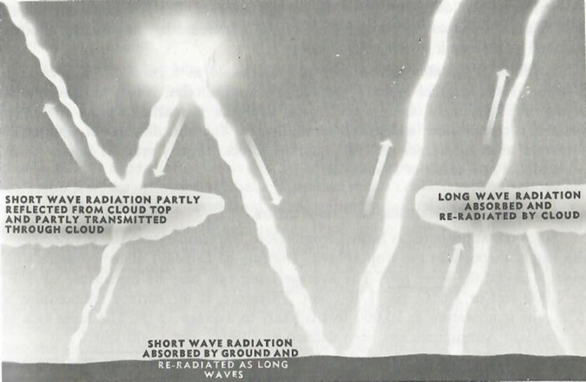
The atmosphere and how it is heated
There are three main ways in which heat may be transferred from one place to another.
Conduction: When heat gradually diffuses through an object, moving from the warmer toward the colder portions.
Convention: If warm air rises & streams through colder air.
Radiation: method of transfer that heat reaches the earth from the sun.
In summary the atmosphere is heated from below.
Heating of the Atmosphere

Slide 8
Atmospheric cooling
At night the temperature of the earth gradually decreases thereby cooling the air resting on it.
During the day, the circulation of the air may be at such that it moves from a warm region over a cooler region, therefore the air is cooled.
Cooling due to this process is called advection cooling.
When rising air becomes saturated, further cooling by expansion will result in condensation of the water vapour with an accompanying release of heat.

Slide 9
Table of heating & cooling of the Atmosphere
Heating of the atmosphere | Cooling of the Atmosphere
Radiation from the ground (effect spread aloft by convection & mechanical turbulence). | Contact with a surface which is cooling by radiation.
Advection (in this case resulting from air moving over a relatively warm surface). | Advection ( in this case resulting in the air moving over a relatively cold surface).
Compression (associate with subsidence). | Expansion (associated with rising air)

Slide 10
Stable and unstable air
Stable air is indicated by a shallow lapse rate.
Unstable air is indicated by a steep lapse rate.
 | Stable Air | Unstable Air
Lapse rate | Shallow | Steep
Cloud | Layer type; fog | Heap type
Precipitation | Of uniform intensity, including drizzle | Showers
Visibility | Impurities are note carried aloft; therefor visibility often poor | Impurities are carried aloft & dispersed; therefor good visibility, except in showers, blowing snow, or blowing dust.

Slide 11
Lifting processes
Convection- is marked by local ascending currents separated by wide areas of gradually sinking air. It is the result of unequal heating of the earth’s surface. Adjacent land and water areas give the most pronounced differences, but different types and forms of land surface, or the presence of sheltering agencies, produce similar results. Convection also develops in cold air which has moved over a warm surface for some time.
Friction between the air and ground- disrupts the lower part of the airflow into a series of eddies. This condition has been referred to as mechanical turbulence. Although the effects are usually confined to the lower few thousand feet of the atmosphere, the vertical extent of the disturbance will depend upon
The stability of the air
The strength of the surface wind
The nature of the ground
Orographic Lift- refers to lift by some prominent topographical feature such as a range of mountains, or a sloping plain.
Frontal Lift- is similar in its main features to orographic lift, but in this case obstruction is a wedge of colder air.
Convergence- in the vicinity of a low pressure area, the surface wind blows across the isobars into the centre of a low. The accumulation of air in the lower levels of the system results in vertical motion.

Slide 12
Atmospheric pressure and air circulation
Atmospheric pressure at specific level may be defined as the force per unit area exerted by the air at that level.
Pressure may be expressed in various units Ex: pounds per square, inch or tons pre square foot.
The unit generally used in meteorology is a related unit called the millibar ( abbreviated mb)
Atmospheric pressure is measured by balancing a column of mercury against the weight of the air expressed in inches or millimetres of mercury as well as millibars.
Station Pressure- is the actual atmospheric pressure at the elevation of the observing station.
In order to compare the pressures at stations of different elevations, it is therefore necessary to reduce the station pressures to a common level.
The level taken as standard Is mean sea level (MSL). The reduction to mean sea level consists in adding to the station pressure weight of an imaginary column of air extending from station level down to MSL. As the weight of such a column will depend upon its temperature.

Slide 13
Horizontal Pressure
Two different pressure elements:
Sea level pressure
Altimeter setting
Both these quantities are pressures reduced to sea level, but the method of reduction is different in the two cases.
The sea level pressure is used in representing the pressure distribution on weather maps. Universally expressed in millibars.
The altimeter setting is a pressure reading which, when set on the subscale of an aircraft altimeter, will cause the instrument to read its true height above mean sea level.
Depression or low- the low is region of relatively low pressure with the lowest pressure at the centre. The size of the low may vary from less than one mile across in the case of a tornado, to many hundreds of miles across in the case of a large depression.
Depressions are sometimes referred to as cyclones.
Trough of low pressure- troughs are indicated by isobars extending outwards from the low in such a way that the pressure is lower along the trough lines than on either side.
Anticyclone or High- a high pressure area is a region of relatively high pressure with the highest pressure at the centre. The isobars are usually father apart near the centre of a high than they are near the centre of a low.
Ridge or Wedge of High Pressure- This pattern is similar to the trough except that the pressure is higher along the ridge line than on either side.
Secondary Low- The secondary depression is a small low within the area of a larger or primary depression.
Col- is a neutral area between two highs and two lows.

Slide 14
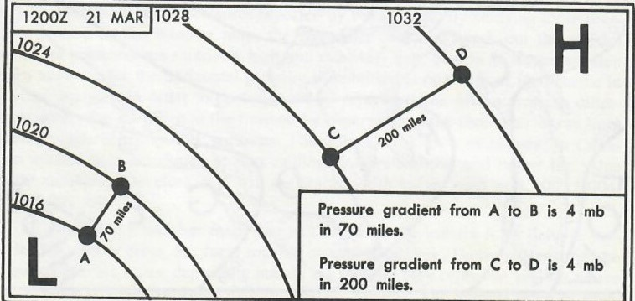
Pressure gradient
Pressure gradient refers to the difference in pressure in the horizontal over a specific distance. More specifically as used in connection with wind, it may be defined as the rate of change of pressure in the horizontal measured at right angles to the isobars.
Pressure gradients may be described as steep, strong, flat , or weak.
The gradient is the strongest where the isobars are closest.
PRESSURE CHANGES AT A STATION OVER A PERIOD OF TIME
The barograph is an instrument which makes permanent record of pressure changes. The changes over a period of time can be observed by the barograph.
An example would be if a depression is approaching the station, the pressure will steadily fall. Once the centre of this low has passed by, the pressure will begin to rise.
The nature of the pressure change at a station is referred to as the pressure tendency.
Determination of pressure gradient at MSL.

Slide 15
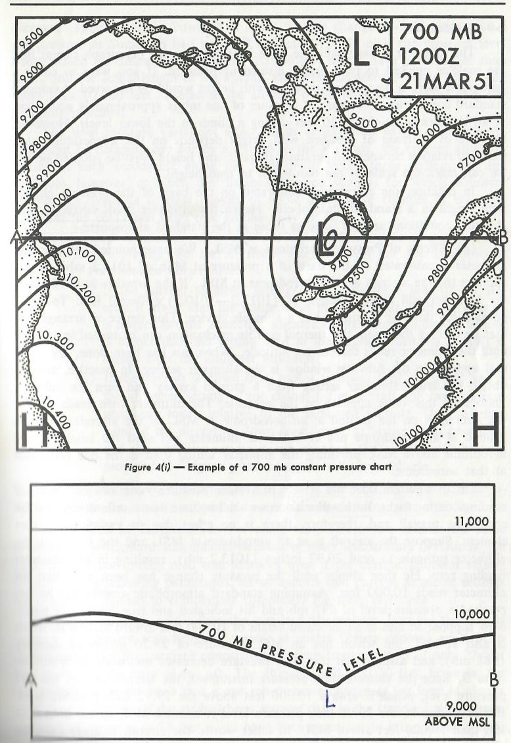
CONSTANT PRESSURE CHARTS
Profile of a 700 mb pressure level along the line from A to B
Each chart represents a specific level, and its variations in height are shown by pencil lines, joining equal height of pressure level above MSL.
These height variations are the result of two factors combined:
Variations in temperature within the layer beneath the pressure level
Variations in the lower level pressure field.
Example of a 700 mb constant pressure chart

Slide 16
Air masses & Fronts
Make special note that an air mass is not the same thing as a pressure system.
The troposphere may be divided into separate sections known as air masses but are separated by relatively narrow transition ones called fronts.
Air masses are often several thousands of miles across.
In winter, arctic air may cover more than half the North American continent.
There are three main air masses:
Arctic
Polar
Tropical
Each of these air masses are subdivided on the basis of moisture content.
If an air mass is dry, it is called Continental.
Air masses that acquire considerable moisture from some source, such as water surface or vegetation, are called Maritime.

Slide 17
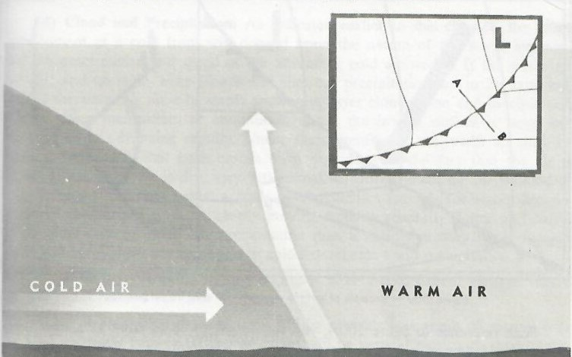
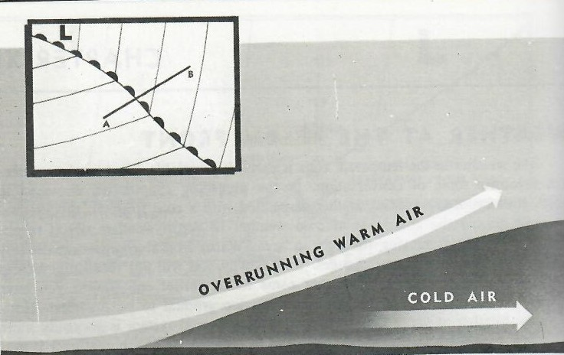
The structure of fronts
A front is the transition zone as it appears on the surface & upper-level maps, while the sloping side of the cold air is called a frontal surface.
Type of fronts:
Cold front- part of the frontal system along which cold air is advancing. It is the leading edge of an advancing part of a cold air mass.
Warm front- a section of the frontal system along which cold air is retreating.
Stationary front- part of the frontal system along which the colder air is neither advancing nor retreating.
The cold front structure
The warm front structure

Slide 18
Surface weather changes associated with cold fronts
Surface wind- changes direction when a cold front passes a station.
Temperature- arrival of cold air will generally result in a decrease in temperature. This decrease may be sudden and may be of considerable magnitude.
The front is really a zone, often of considerable width, that the air immediately behind the front will have been warmed in lower levels as a result of its passage over a warmer surface. It may be many hours after the frontal passage before the temperature has dropped to the true value for the cold air mass.
Moisture content- the onset of cold air generally results in a drop in the dew point temperature. This is particularly noticeable if the cold air mass is the dry continental arctic.

Slide 19
Surface weather changes associated with cold fronts
Cloud & precipitation- cloud development at the cold front will depend upon the nature of the warm air mass and the exact nature & speed of the advancing cold air wedge.
If warm air is moist & unstable, heap clouds & showery precipitation are to be expected. Should a warm air mass be stable & moist, layer clouds form & precipitation will be either intermittent or continuous, unless the frontal surface is steep & the cold air is advancing rapidly.
Under these conditions, the warm air may be lifted so vigorously that heap clouds form regardless of the fact that the air is stable.
If the warm air is dry, very little cloud will form unless the air is lifted to a great height.
A slowly moving front is generally flatter and has a much wider area of cloud & precipitation than a rapidly moving front.

Slide 20
Cold fronts
Visibility usually improves after cold frontal passage, two main reasons why:
The air behind the cold front will be unstable as a result of passing over a warm surface. Therefore there will be a vertical motion to carry pollution aloft.
Because the front lies in a trough, the approach of the system will be accompanied by a decrease in pressure. A marked rise will be noticed when the trough has passed.
How to Recognize Cold Fronts During Flight
During a westbound flight over flat terrain, you see a long line of heap clouds on the northwest or west horizon, it is an indication that you are flying toward an approaching active cold front.
If the main line of cloud has cirrus and towering cumulonimbus clouds, it is an indication that thunderstorms are associated with the front, flight through the front will require carful planning.
When no cloud is associated with the front, a combination of turbulence, wind shift and temperature change will indicate that you have flown through the frontal surface, although these changes will be mot marked in the lower levels.

Slide 21
Flight Problems Associated with cold fronts
Windshifts- occurs at the frontal surface rather than at the front. The windshift encountered in flying through a cold frontal surface may be abrupt. You can tell you have passes through the frontal surface by the temperature change.
Ceiling & Visibility- in the case of active col fronts moving with moderate or rapid speed, the width of the area of frontal weather Is generally less that 50 miles.
Turbulence- It is well to remember that as a rule you may expect a rough flight in the vicinity of an active cold front.
Precipitation & icing conditions- with active cold fronts, the frontal rain or snow belt is usually relatively narrow.

Slide 22
Weather at the warm front
Weather in the temperature zone is extremely variable.
Warm frontal changes are usually less abrupt than cold frontal changes.
Weather at the warm front portion of a frontal system is generally extensive that at the cold front portion, in many parts of the continent it may take form of a cloud system & precipitation which cover many thousands of square miles.
Every temperature rise is not associated with a warm frontal passage.

Slide 23
Weather at the warm front
Windshfit - with the passage of a warm front, the wind direction will change from that of the cold air to that of the warm air. This will always be in the form of a veer, but it is much more gradual than in the case of the cold front. Warm frontal zones are generally much wider that cold frontal zones.
Temperature- passage of warm front results in an increase in temperature, although not as rapid.
The proximity of the warm air to the surface may result in a slight rise in temperature even before the warm front reaches the station.
Moisture content- when the warm air mass is tropical in origin, the passage of the warm front will result in a marked rise in dew point.

Slide 24
Weather at the warm front
Cloud & precipitation- as warm air sweeps up the cold wedge, it reaches the regions of lower pressure, expands & cools causing condensation.
A moist stable overrunning warm air mass will produce an extensive area of layer clouds from which light to moderate continuous precipitation will fall for a considerable distance ahead of the surface front.
These clouds ahead of the surface front, may be, cirrus, cirrostratus, altostratus & nimbostratus.
If overrunning warm air is unstable, cumulonimbus clouds will be found embedded in the main cloud deck. In this case precipitation will become heavy beneath the cumulonimbus clouds.
Visibility- Improvement in visibility when a warm front passes a station is not very marked if the front lies between Maritime Polar & Tropical air.
Poor visibility can usually be expected in both air masses, although the visibility is usually worse in the cold air just ahead of the front owing to fog & precipitation.
Visibility in the frontal zone may occasionally be zero.

Slide 25
How to recognize active warm fronts during flight
In approaching an active warm front from a cold air side, the first sign of the front is cirrus cloud. Next a layer of cirrostratus is encountered. This cloud does not obscure the moon, stars or sun, but often causes a halo about the sun or moon.
The cloud may merge with altostratus & altocumulus which will gradually lower from near 20,000 feet to 6,500 feet.
From the thick altostratus, intermittent light precipitation may be encountered. If the altostratus deck is still quite high, this precipitation may not be reaching the ground. As flight is continued, the altostratus-altocumulus deck will lower and the precipitation will increase with intensity.
The upper deck will lower to nimbostratus & merge with the lower deck to form a solid deck of cloud near the surface to 25,000 feet or more.

Slide 26
FLIGHT PROBLEMS ASSOCIATED WITH THE WARM FRONT
Windshift- will occur at the frontal surface rather than at the front
The windshift is such that an alteration to starboard is required, no matter which way you are flying through the front.
Will be most marked in the lower levels
Ceiling & visibility- there is a wide area with a low ceiling & restricted visibility.
Warm fronts often more very slowly.
When rain begins to fall from the cloud in the overrunning warm air, masses of irregular cloud may form in the cold air.
These clouds cause very low ceilings.
For a distance of 50 to 100 miles in advance of the front, the cold air is shallow, often the cloud base resets on the ground as fog.
Turbulence & thunderstorms- The main problem of turbulence arises when cumulonimbus clouds are embedded in the main cloud deck
The main difficulty in flight planning at moderate altitudes through regions of warm frontal thunderstorms lies in the fact that they may be scattered through the main frontal cloud and you have no way of knowing exactly when you will encounter them.
Precipitation & icing conditions- If you are approaching an active warm front from the cold air side, precipitation will begin in the region where the altostratus cloud deck is from 8,000 to 12,000 feet above the surface of the earth.
If you are flying just below the cloud base, you may encounter precipitation although it is not reported by observers at the ground. This is because the precipitation is evaporating before it reaches the ground.
At a well developed warm front during winter, temperatures in the cold air are generally below freezing & temperatures in the lower few thousand feet in the warm air are above freezing.

Slide 27
Weather at trowals & upper fronts
Trowal - trough of warm air aloft is formed when a cold front overtakes a warm front and the warm air is forced aloft in the trough formed by the two wedges of cold air.
If you are flying toward an approaching trowal, the cloud pattern is very similar to that of a warm front.
If you approach a trowal from behind, the cloud structure may resemble a cold front but the effects on flight are different.
The Upper Warm Front
If the warm front leaves the ground and rides over a colder mass of air, the cloud system is still present, although there is no change of air mass in the lower levels.
If a great deal of rain falls from the warm air into the cool air & then into the cold air at the surface, clouds may form in this cold air.
When a warm frontal surface is flat for some distance ahead of the front and then abruptly steepens, the weather pattern of the warm front will be found some distance ahead of the surface front.
The Upper Cold Front
The main thing to note is that a station in the cold air will experience most of the changes associated with a cold frontal passage, except for the windshift, and temperature change.

Slide 28
Clouds, precipitation & fog
Two main expressions of water vapor content:
Dew point temperature: the temperature at which air would become saturate if cooled at constant pressure.
Relative humidity: The actual amount of water vapor in the air divided by the amount of water vapor which would be present if the air were saturated at the same temperature and pressure.
Note that dew point indicates indirectly the amount of water vapor present, while the relative humidity expresses the degree of saturation.
Requirements for condensation in the atmosphere:
High relative humidity
Nuclei- tiny particles on which the water vapor can condense
Cooling of the air

Slide 29
Clouds
Clouds are classified according to appearance & form.
Clouds may be divided into four families.
High
Middle
Low
Common appearances, but have base varying within ranges of both middle and low families. These are called vertical development.
High clouds: heights of base above ground level – 20,000 to 40,000 feet.
Cirrus
Cirrostratus
Cirrocumulus
Different types of clouds
Middle Clouds: Height of base above ground level - 65,00 to 20,000 feet.
Altostratus
altocumulus
Clouds of vertical development: Height of base above ground level – 1,500 feet or higher.
Cumulus
cumulonimbus
Low clouds: Height of base above ground level - 0 to 6,500 feet.
Stratus
Stratocumulus
nimbostratus

Slide 30
clouds
Cirrus- fibrous wisps of delicate white cloud formed by ice crystals & showing up against the blue of the sky.
Cirrostratus- a thin whitish veil through which the sun or moon can be seen with the outline clear except when they are low on the horizon.
Cirrocumulus- small rounded masses or white flakes with slight or no shadows, arranged in groups or lines with ripples like sand on the sea shore.
Altostratus- a thick veil of cloud usually grey, sometimes steely or bluish in color. Generally covers the whole sky.
Altocumulus- a layer or series of patches of rather flattened rounded masses of cloud. The cloudlets are arranged in groups, in lines, or in waves, following one or two directions & are sometimes so close together that their edges join.
Stratus- a uniform layer of cloud resembling fog but not resting on the ground. Does not show permanent markings on its lower surface.
Stratocumulus- a layer or series of patches composed of rounded masses which may show considerable shading.
Nimbostratus- a low layer of dark grey color, usually uniform & feebly illuminated, seemingly from the inside.
Cumulus- dense clouds with vertical development. The bases are almost horizontal & form at a uniform height; the tops are rounded.
Cumulonimbus- heavy masses of cloud with vertical development extending to well above freezing level.

Slide 32
Precipitation & Clouds
Precipitation can take many forms :
Drizzle
Freezing drizzle
Hail
Ice prisms
Ice pellets
Rain
Freezing rain
Snow
Snow grains
Snow pellets
Precipitation form | Cloud type
Drizzle, freeing rain, snow grains | Stratus & stratocumulus
Snow (continuous), rain ( continuous) | Thick altostratus and nimbostratus
Snow (intermittent), rain ( intermittent) | Thick altostratus & stratocumulus
Snow showers , rain showers | Altocumulus, heavy cumulus and cumulonimbus
Snow pellets, hail, showers of ice pellets | Cumulonimbus
Ice pellets ( continuous) | Any cloud that will give rain , since non-showery precipitation in the form of ice pellets is usually the result of the rain drops freezing.
Ice prisms | No cloud necessary

Slide 33
Fog
Fog is essentially a cloud formation in the shallow layer of air next to the earth’s surface.
The main cooling processes which causes fog:
Radiational cooling of the ground may be communicated to the air above, causing radiation fog. This will occur at night.
Air moving from a warm surface to a colder surface may be cooled to the extent that fog forms. Since the horizontal movement of air is called advection, this fog is often called advection fog.
As air moves up a slope, the cooling due to expansion may cause condensation. This is the same process at which causes orographic cloud, but any part of the cloud which may rest on the upper slopes is called upslope fog.
Steam Fog or Arctic sea smoke:
When cold air first moves over the water, steam fog will appear, but as the air moves further over the warm water, heap cloud develops.
In the arctic areas this fog forms as the air moves from the ice surfaces to open areas of warmer water.
Frontal Fog
Warm fog fronts are the most extensive and are caused by the cold air.
The fog which follows the warm front is due to advection cooling as warming air moves over a cooler surface.

Slide 34
Aircraft icing
Ice accretion: the rate varies with
temperature & size of water drops
Water content of air
Kinetic heating
Shape of airfoils & other aircraft components
Mechanical flexion & vibration
Icing that forms on an aircraft during flight though cloud and precipitation is referred to as rime or clear.

Slide 35
V I s I b I l t y
One of the most important elements of the weather from the standpoint of aircraft take-off & landing.
Determines whether or not an airport is open to traffic.
Slant visual range- the most distant point on the ground that can be seen from the aircraft.
Vertical visibility- term used for describing observed & expected conditions when surface-based obstructions are present.

Slide 36
Restrictions to Visibility
Cloud
Precipitation
Fog
Haze
Smoke
Blowing dust
Blowing snow
Surface visibility will depend largely on the stability in the lower levels. If the air is stable, impurities from factories will be trapped in the lower layers. Stable air is also favourable for drizzle and fog. If air is unstable, air may cause blowing dust or snow.

Slide 37
turbulence
Turbulence is an irregular motion of air resulting from the formation of eddies or vertical currents in the air.
Causes of turbulence:
Mechanical agencies
Thermal agencies
Frontal conditions
Wind shear
Mechanical agencies: friction between the air & the ground results in a series of eddies developing in the lower portion of the air stream. Aircrew flying in this turbulent zone encounter a marked choppiness.
Depends upon three factors:
The strength of the surface wind
The nature of the surface
Stability of the air
Thermal agencies: turbulence often results from the heating of the earth’s surface by the sun.
Frontal systems: turbulence associated with a frontal system may be due to two factors
The uplift imparted to the warmer air by sloping frontal surface
Friction between the opposing air currents of the two air masses.
Wind shear: Any marked changes in wind with height may produce a local area of turbulence.

Slide 38
Mountain waves
Features of mountain waves:
When air crosses a range of mountains, a series of waves, spaced at intervals of two to twenty miles, may be set up in the airflow downstream from the range.
Each wave marks a place where the air jumps almost vertically to the crest of the wave.
The strongest wave of the system is the one closest to the range.
Effects of Mountain Waves on Aviation:
Present problems because of vertical currents, turbulence, horizontal wind shear, altimeter errors & icing.
Rules often used by pilots as a basis for developing procedures for conducting flights through mountainous regions at medium altitudes.
Stay out of rotor and cap clouds
Maintain close watch on the altimeter and allow for a possible error of 1000 feet.
Use updraft areas to gain extra altitude to compensate for the next downdraft.
Approach a mountain range at a 45 ̊ angle rather than at a right angle so that a turn away can be made easily if it appears dangerous to continue.
If flight is parallel to a range in a steady downdraft, an updraft can be found by changing course to fly a few miles either up or downwind. If very close to range, it is wiser to move downwind to find updraft.

Slide 39
Stages of thunderstorms

Slide 40
Thunderstorms
Structure & development of a Thunderstorm
Thunderstorm cloud is made up of separate cells in various stages of development with considerable connective cloud between.
Requirements for thunderstorm development
Unstable air to high levels
High relative humidity
Some lifting agency to set the air in motion
Cumulus Stage- At this stage, an updraft prevails throughout the cell. The maximum vertical speed of the updraft during this stage usually occurs in the upper part of the cell during the later part of the stage. At every level within it, temperatures are higher than at the same level in the surrounding air.
Mature stage- As the updrafts penetrate to greater heights, the presence of an abundance of ice crystals & water droplets leads to the formation of precipitation. The appearance of precipitation at the surface marks the transition from cumulus to mature stage.
Dissipating Stage- The downdraft gradually spreads through the area of the cell until it occupies all of it except a portion at the top where the updraft persists. When this development has been reached the storm is said to be in the dissipating stage.

Slide 41
Wind
Wind direction is considered as the direction from which the wind is blowing.
When describing changes in wind direction at a station, or relative to an aircraft in flight, the forecaster refers to a clockwise change as a veer and counter clockwise change as a back.
There are two main forces that act upon the air.
The force which causes the air to move horizontally is due to the pressure gradient. It forces air from a region of high pressure into a region of low pressure.
As soon as the air begins to move because of pressure gradient, a deflective force due to the earth’s rotation affects the direction of motion. As a result the air swings to the right in the northern hemisphere and finally flows parallel to the isobars.
Friction is a force that effects surface wind speed and direction. The force of friction results from the air moving along the ground. The result is that wind speed is less than the speed indicated by the pressure gradient on the weather map, and the direction is changed so that the wind blows across the isobars at a slight angle into a center of low pressure and out of a centre of high pressure.
The more the friction the greater angle. Although it seldom exceeds a value of 40 degrees.
Assuming that the surface wind is not affected by local topographical effects, it is interesting to note that during an ascent from the surface to 2,000 or 4,000 feet, the wind will veer & increase in speed, while during a descent from this level to the surface, the wind will back & decrease in speed.

Slide 42
Gustiness- a gust is a comparatively rapid and brief increase in the wind speed. It is often associated with rapid fluctuations in the wind direction.
There are two principle causes for gusts.
Mechanical turbulence- this is an eddying motion resulting from friction between the air and the ground.
Unequal heating- of the earth’s surface: If one portion of the earth’s surface becomes heated to the extent that the surrounding colder air will rush in, a gust may occur.
Squalls- a squall occurs when the wind speed increases suddenly & maintains a peak speed over a period of minutes before diminishing.
Squalls are due to :
Rapidly moving cold fronts
Thunderstorms
The main difference between the squall and the gust is one of duration. As in the case of the gust, the change in wind direction.
Because of daytime surface heating, the eddying motion caused by friction between the air and the ground( mechanical turbulence) often extends to 3,000 feet or higher. This turbulent region is really a mixing zone, with the result that the direction and speed of the 3,000 foot wind tends to be transferred to the surface.
During the night, the surface cooling reduces the eddy motion of the air in the lower levels. The surface wind tends to assume its normal direction and speed.
In summary: day- surface wind veers and increases. Night- surface wind tends to back and decrease.
WIND

Slide 43
wind
Land & sea breezes- These variations affect coastal areas. During the night the land cools rapidly while the water surface remains at almost the same temperature as during the day. Thus a stage will be reached at which land is colder than the water surface and the air over the land becomes colder than the air over the water. This results in the pressure over the land being higher than over the water. Although this pressure affect does not appear on the night weather maps, the gradient is often strong enough to cause wind to blow from the land to the water. This is the land breeze.
Sea Breeze- during the day, if the land heats rapidly, the water surface will be colder of the two, the air over the water will be colder than the air over the land. Thus superimposed on the pressure system, there will be this local system with the higher pressure over the water. Accordingly, the wind blows from the water to the land as the sea breeze.
Both these breezes are very local. They do not extend to any great height, and affect only a narrow area along the cost.
Katabatic effects: Katabatic winds are winds which blow down ice-free slopes at night or blow down ice-covered slopes night and day.
Minor Topographical Effects: Mountain ranges & valleys affect the direction and speed of the surface wind.
Barrier effect- A mountain barrier may act as a dam which holds back the air and deflects it parallel to the range.
Funnel effect- if there is a pass in the mountain range, the wind will gush through this pass with considerable speed. The direction is that a pass and the speed is considerably higher than the pressure gradient would indicate.
Valley effect- A weak surface wind tends to follow any well defined valley rather than the isobaric pattern.

Slide 44
Wind
If during a flight you experience a marked port drift, then you will be approaching an area of higher pressure. If the drift is to starboard, you are approaching an area of lower pressure.
During a flight at higher levels, the observed wind will indicate the pressure pattern at flight level.
If you were flying at a constant pressure level, a marked port drift would indicate that the aircraft is gradually gaining altitude, while a marked starboard would indicate that the aircraft is gradually losing altitude.
In summary the wind blows as a result of pressure difference in the horizontal. The greater the pressure difference for a given distance, the stronger the wind.

Slide 45
wind shear
Wind shear is the sudden “tearing” or “shearing” effect encountered along the edge of a zone in which there is violent change in wind speed or direction.
Wind shear encountered near the ground is more serious and potentially very dangerous.
There are four common sources of wind shear encountered near the ground:
Frontal activity
Low level wind shear associated with thunderstorms
Temperature inversions & strong surface winds passing around natural or man-made obstacles.
Wind shear is usually only a problem in fronts with steep wind gradients. If the temperature difference across the front at the surface is 5̊ c or more & if the front is moving at a speed of about 30 knots or more, wind shear is likely to be present.
Frontal wind shear is a phenomenon associated with fast moving cold fronts but can e present in warm fronts as well.
Low- level wind shear, associated wit thunderstorms, occurs as the result of the phenomena, the gust front & downburst. As the thunderstorm matures, strong downdrafts develop, strike the ground & spread out horizontally along the surface well in advance of the thunderstorm itself.

Slide 46
How to read weather
Nav Canada
Four flight
Windy TV App
AeroWeather App

Slide 47
Graphic area forecasts(gfa)
GFA consists of a series of temporally adjusted weather charts, each depicting the most probable meteorological conditions expected to occur at or below 24 000 ft over a given area at a specified time.
Primarily designed to meet general aviation and regional airline requirements for pre-flight planning in Canada.
GFA charts are issued four times daily, approximately 30 min before the beginning of the forecast period.
The GFA is issued at approximately 2330,0530,1130 and 1730 UTC and is valid at 0000,0600,1200 and 1800 UTC respectively.
Each issue consists of six charts: two charts valid at the beginning of the forecast period; two charts valid six hours into the forecast period; and the final two charts valid twelve hours into the forecast period.
One chart depicts clouds and weather while the other chart depicts icing, turbulence and freezing level.
An instrument flight rules (IFR) outlook for an additional 12-hr period is also included in the comments box of the final clouds and weather chart.

Slide 48
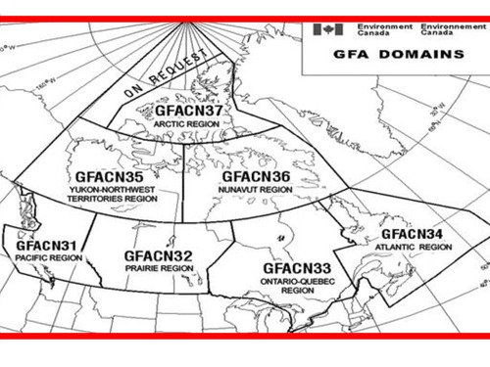
COVERAGE AREA
There are seven distinct graphic area forecast (GFA) areas, covering the entire Canadian domestic airspace (CDA), over which Canada is responsible for the provision of air traffic control services.

Slide 49
UNITS OF MEASURE
Speeds in the GFA are expressed in knots and heights in hundreds of feet. Horizontal visibility is measured in statute miles and at all times are stated in Coordinated Universal Time.
ABBREVIATIONS AND SYMBOLS
Only standard meteorological abbreviations are used in the GFA. Symbols used in the GFA are consistent with those found on similar meteorological products described in this document such as significant weather prognostic charts (MET 12.0).

Slide 50
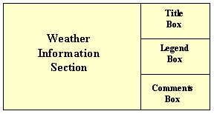
TITLE BOX
LAYOUT
The title box includes the chart name; the issuing office four-letter identification; the name of the GFA region; the chart type; the date and time of issue; and the valid date and time of the chart.
Each GFA chart is divided into four parts:
Title box.
Legend box.
Comments box.
Weather information section.
COMMENTS BOX
Provides information that the weather forecaster considers important. It is also used to describe elements that are difficult to render pictorially or, if added to the depiction, would cause the chart to become cluttered.
LEGEND BOX
Includes weather symbols that may be used in the weather information part of the GFA chart. It also includes nautical mile scale bar to facilitate the determination of distances.

Slide 51
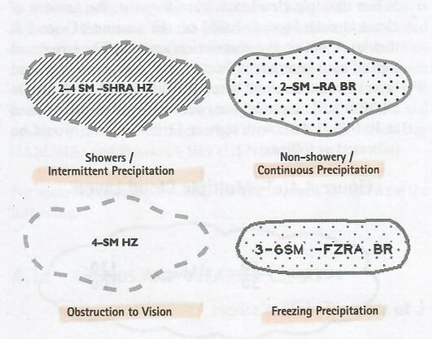
Clouds
Organized area of clouds ( scalloped border)
Unorganized area of clouds ( no scalloped border)
Multiple cloud layers
Surface based layers- the vertical visibility into surface based layers is measured in hundreds of feet AGL.
Visibility- the forecast visibility is measured in statute miles. When the visibility is expected to be greater than 6 SM, it is indicated as P6SM.
Weather and obstructions to vision- forecast weather is always included immediately after visibility. Obstructions in vision are only mentioned when visibility is forecast to be 6 SM or less. Only standard abbreviations are used to describe weather and obstructions to vision. Areas of showery or intermittent precipitation are shown as hatched areas enclosed by a dashed green line when color is used.

Slide 52
Isobars
CONVECTIVE CLOUDS AND SHOWERS
Abbreviation | Description | Spatial Coverage
ISOLD | Isolated | 25% or less
OCNL | Occasional | 26-50%
FRQ | Frequent | Greater than 50%
NON CONVECTIVE CLOUDS AND PRECIPITATION
Abbreviation | Description | Spatial Coverage
LCL | Local | 25% or less
PTCHY | Patchy | 26-50%
XTNSV | Extensive | Greater than 50%
Isobars are drawn at 4-hPa intervals from a reference value of 1000 hPa.
SURFACE WINDS
Wind gusts are indicated by the letter “G”, followed by the peak gust speed in knots.
G35

Slide 53
ICING, TURBULENCE AND FREEZING LEVEL CHART

Slide 54
Icing- depicted in blue when shown in color and indicated whenever moderate or severe icing is forecast for the coverage area. The bases ad tops of each icing layer, measured in hundreds of feet above mean sea level, as well as the type of icing will be indicated. Areas of light icing are described in the comments box.
If icing is expected to be present during only part of the forecast period covered by the chart, the time of occurrence of the icing is indicated in the comments box.
Areas of severe icing are indicated with a denser stippling.
Turbulence- Depicted in red when shown in color and indicated whenever moderate to severe turbulence is forecast for the coverage area.
An abbreviation indicating the cause of the turbulence will be included. Turbulence due to mechanical turbulence, low level wind shear, lee/mountain waves, a significant low level jet or in clear air will be indicated as MECH, LLWS, LEE WV, LLJ, or CAT, respectively.
Severe turbulence is depicted with a higher density of hatching.
Freezing level- freezing level contours are indicated on GFA by dashed lines. The height of the freezing level is indicated to the nearest multiple of 2 500 ft using the standard heights in hundreds of feet above sea level.
Low level jet (LLJ)- included on the GFA icing, turbulence and freezing level chart when it is expected to have a peak core speed of 50 kt or more. It may be included at speeds between 35 and 45 kt when significant associated turbulence or shear is expected.

Slide 55
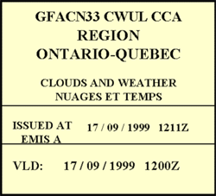
GRAPHIC AREA FORECAST AMENDMENTS
Once issued a significant meteorological information (SIGMET) or AIRMET message automatically amends the current and relative GFA. The remark (RMK) found in the national version of those messages indicates the GFA region(s) to which the SIGMET or AIRMET applies.
GRAPHIC AREA FORECAST CORRECTIONS
When reissued, the correction code “CCA” is added to the first line of the title box to indicate the first correction, “CCB” for the second. “CCC” for the third, etc.

Slide 56
The end

